Slide 1
Structures & Spatial Awareness
CCTV Headquarters in Beijing, China

Slide 2
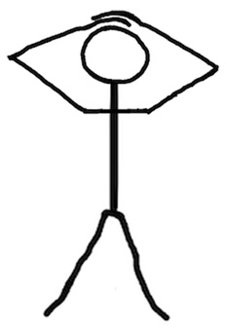
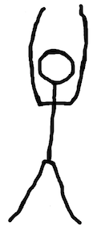
Structures react to gravity loads in many ways, but there are two main forces at work:
COMPRESSION
TENSION
Objects are getting PRESSED/CRUSHED
Objects are getting PULLED
Stand up, and try it out!

Slide 3
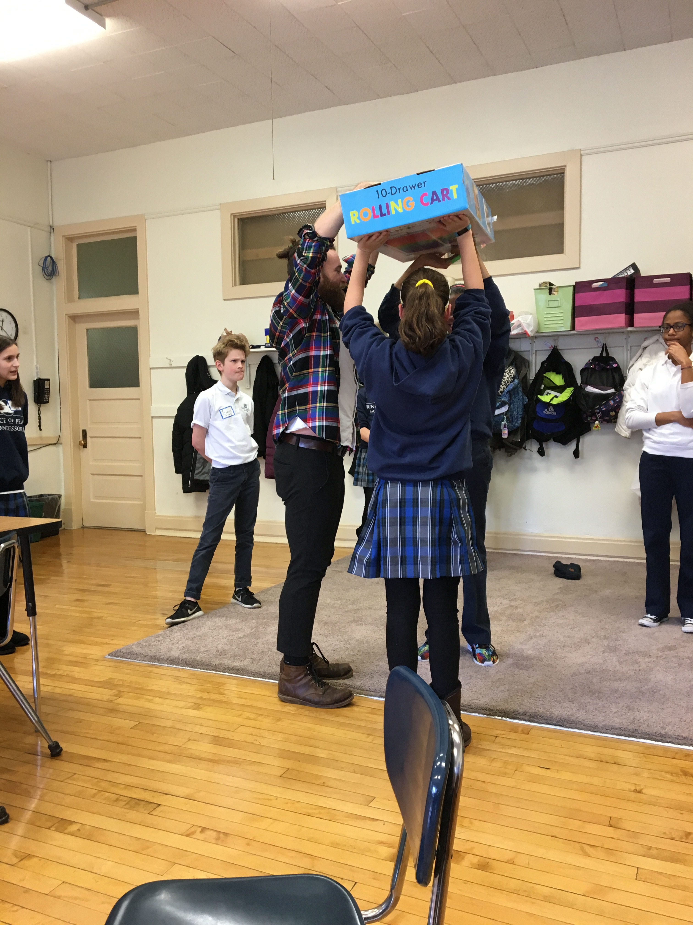
COLUMN
A COLUMN is a vertical linear element used to support a beam, floor, or roof
BEAM
A BEAM is a horizontal linear element spanning across an opening, supported at both ends

Slide 4
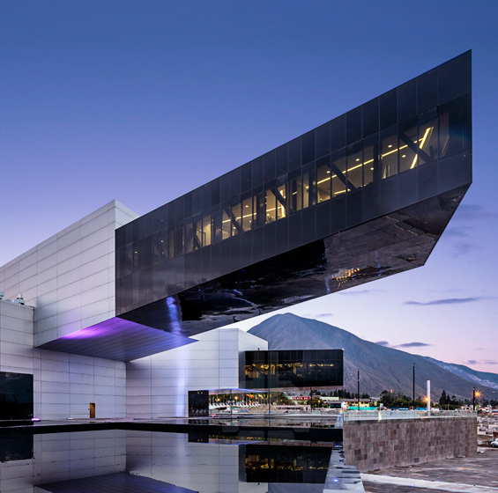
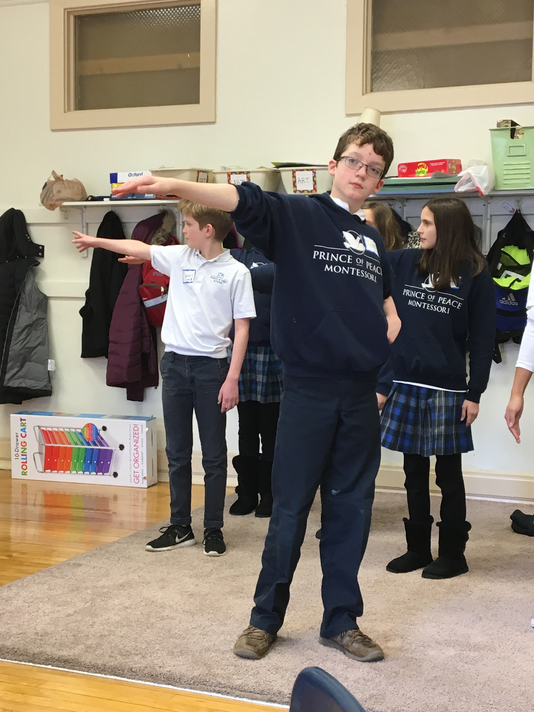
CANTILEVER
A CANTILEVER is a horizontal structural element supported only at one end
FRAME
A FRAME is a rectangular arrangements of linear structural elements.

Slide 5
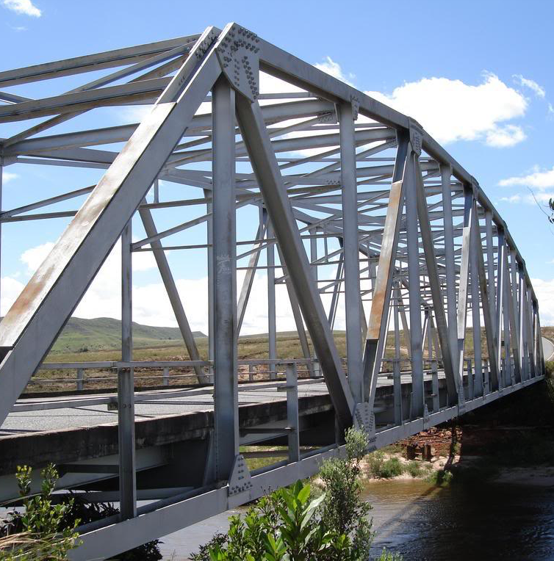
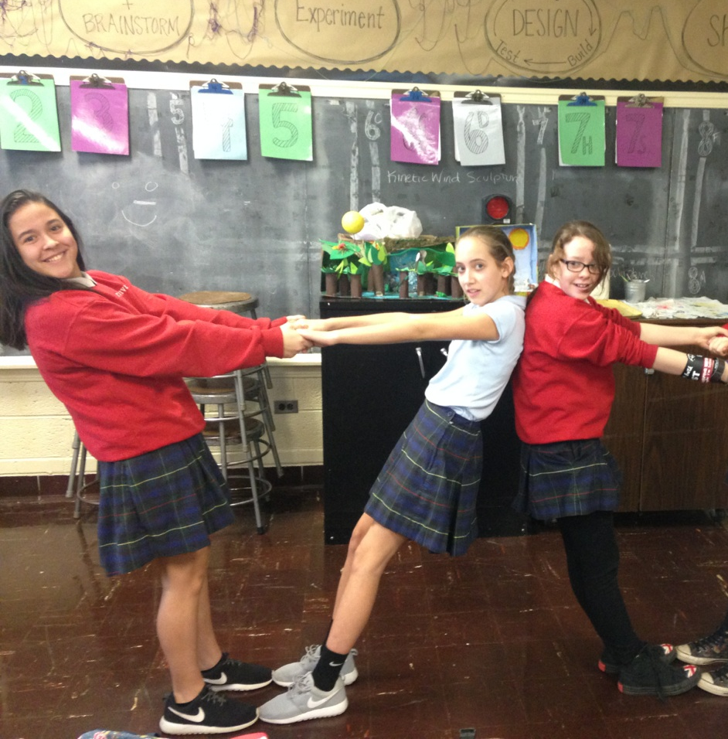
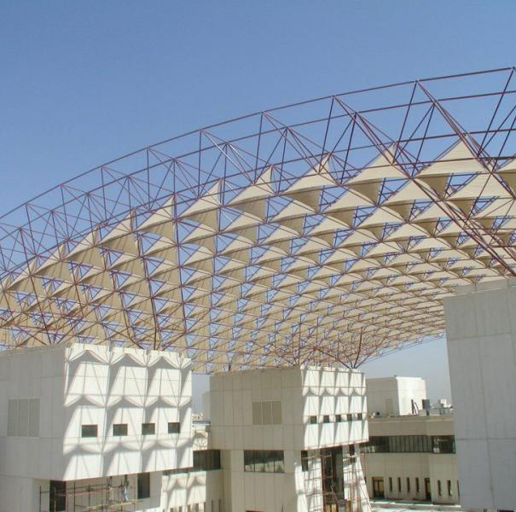
SPACEFRAME
TRUSS
A TRUSS is a 2-dimensional triangular arrangement of linear structural elements.
A SPACEFRAME is a 3-dimensional triangular arrangement of linear structural elements.

Slide 6
Spatial Awareness
Photo: the most crowded classroom (221 students) in the world, in England, London.
Aren’t you glad you don’t go here?
Understand how you relate to space in different areas of your school. Measure the space first, and then find out how many people it can hold.
(Teachers: more detailed instructions and additional activities were sent as handout)

