Slide 1
WEEK 4: SUSTAINABILITY
How can the built environment help the natural environment?

Slide 2
What Is SUSTAINABILITY?
Write on the board what you think of when you think of the word “Sustainability”
Did your classmates write anything you hadn’t thought of?

Slide 3
Two Aspects of Sustainability
SUSTAINABLE ACTION
SUSTAINABLE DESIGN
You know these!
Recycle your used materials
Use reusable bags, bottles, etc.
Turn electronics and lights off when you are not using them
Don’t buy things that you do not need
Do you know about these yet?
Creating products/structures that have the least negative impact on the health of people, the economy of an area, and the environment
Meeting the needs of the present generation without depleting the ability of future generations to meet their own needs

Slide 4
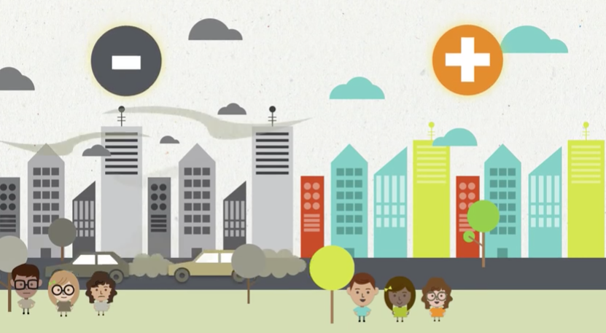
Sustainable Design (Green Design)
Introduction to sustainable design:
https://www.youtube.com/watch?v=MyIOtsx3wDs
Now that you have a broad understanding of what sustainable design is, let’s look at sustainable building practices and how we can help to green our food spaces!

Slide 5
What Makes a Space Sustainable?
Location & Transportation
Sustainable Site
Water Efficiency
Energy Efficiency
Materials
Resources
Indoor Air Quality
There is more to it, but these are a great start!

Slide 6
LOCATION & TRANSPORTATION
Public Transportation
Is it in an area where you can walk to many of the places that you need to go?
Is there public transportation available nearby?
Does your structure encourage alternative transportation by providing bike racks?

Slide 7
SUSTAINABLE SITE
Adaptive Reuse in Denver
Does your site already exist? This means not destroying any natural land to build.
Does your site help manage rainwater? This can be achieved with pervious pavement, rain gardens, and green roofs, along with other strategies.

Slide 8
WATER EFFICIENCY

Slide 9
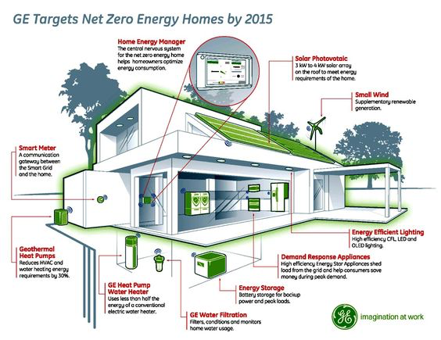
ENERGY EFFICIENCY

Slide 10
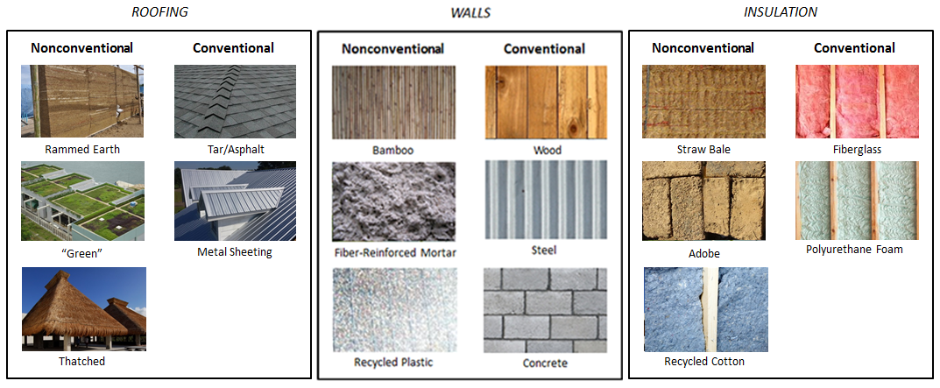
MATERIALS
Nonconventional (Sustainable)
Conventional
(Less Sustainable)
Recycled & renewable materials are the best option. They divert waste from landfills and encourage the use of renewable resources.

Slide 11
RESOURCES
Compost Bins
How much waste is your space creating? How are you working to minimize it?
Are you participating in a recycling program?
Are you utilizing composting?
What other creative ways can help minimize the amount of waste that leaves your space?

Slide 12
INDOOR AIR QUALITY

Slide 13
Sustainable Play Spaces
Lion’s Park in Alabama
University students used 2000 recycled steel drums that had been donated to creative this play space

Slide 14
Sustainable Play Spaces
Wikado Playground in The Netherlands
Old windmills and modern wind turbines were creatively reused to create this maze-like play structure

Slide 15
Sustainable Play Spaces
Rubber Tree Playground in Thailand
This play space is made entirely of discarded tires and held together with a bamboo frame
The play space was created for refugee children on the border of Thailand and Myanmar

Slide 16
Sustainable Play Spaces
The Geopark in Norway
This play was built in the base of Norway’s oil industry and took advantage of discarded components of oil rigs

Slide 17
Sustainable Play Spaces
Carlos Teixeira’s ‘The Other, The Same’ installation in Brazil
The labyrinth in this photo was created with recycled cardboard

Slide 18
Sustainable Play Spaces
Tempelhofer Feld in Berlin, Germany
This giant park was created on the reclaimed site of their old airport, so you can bike, walk, or windsurf on the old runways

Slide 19
Additional Resources
LEED LEGO Activity: http://practiceofarchitecture.com/2013/09/03/using-legos-to-teach-the-next-generation-about-green-building/#jp-carousel-738
This would be an awesome activity to do if you have the time for it. The University of Illinois created a LEED Certification System for a Lego Home and it will really enforce how that system works and what specific things make a building/site sustainable.

