Slide 1
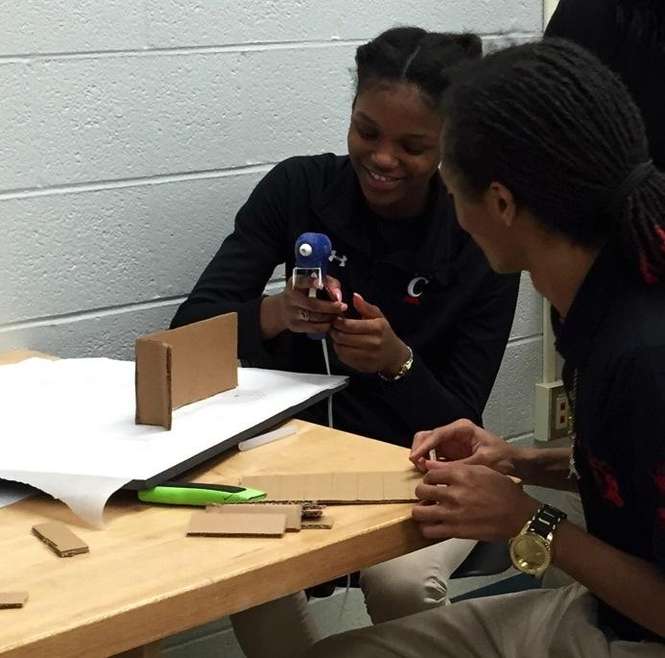
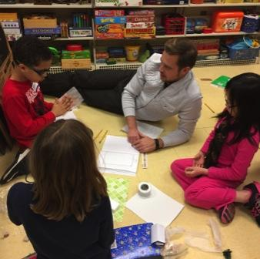
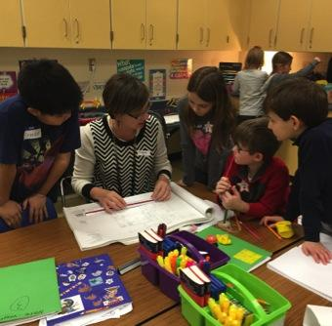
Food for Thought

Slide 2
Welcome to Design LAB!
Over the next 16 weeks (or so), you will be participating in the Design LAB program. It will be fun, but it also may challenge you in ways you might not be used to – like seeing how creative you can be when trying to solve problems that people all over the world are facing.
Your first challenge is to learn about where our food comes from, where we get it, and where we eat it. Then, use what you learned to create a model of one of these spaces. How will your space impact the world?

Slide 3
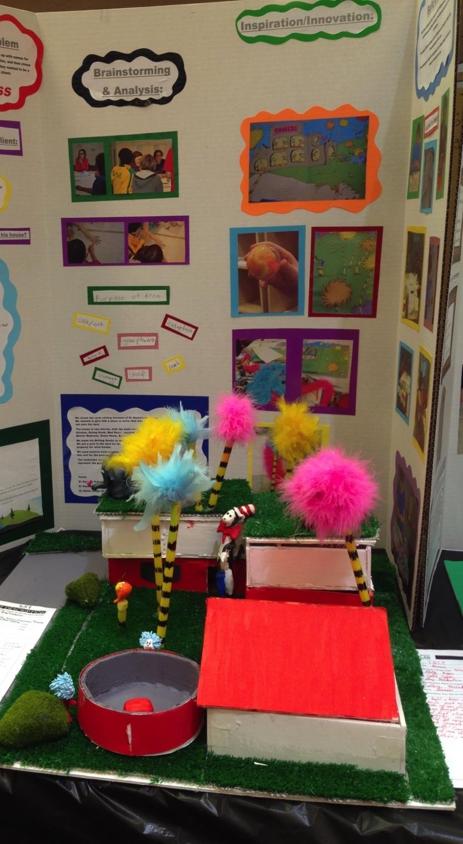
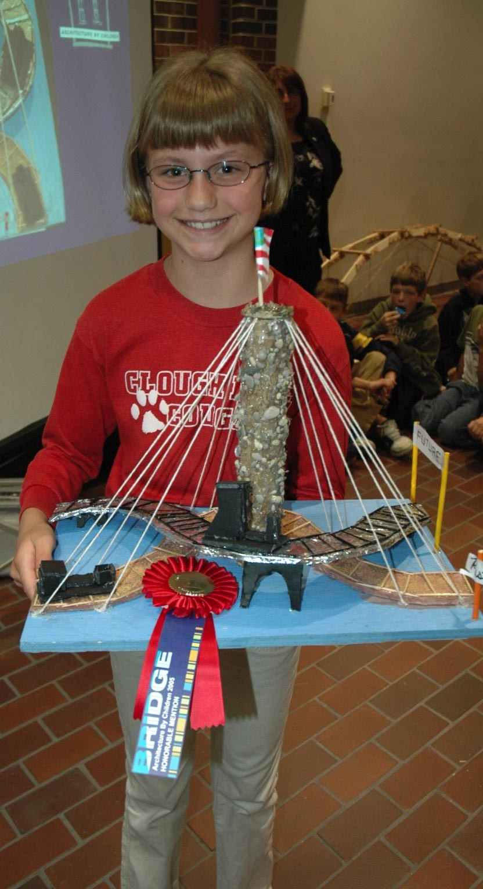
What is this, a space for ants?!
This photo shows the end product of the program: the model. This is what you are working towards. When the program is over, we hope you will have a model that you can be really proud of!
For that to happen, you need to follow along with the steps of the program. Trust the process and learn from every step of it.

Slide 4
THE DESIGN PROCESS
This is the process you will follow during this program
There are variations of this process, but they all accomplish the same thing: they break down your design problem into manageable chunks, taking the problem one step at a time to a solution

Slide 5
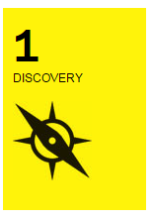
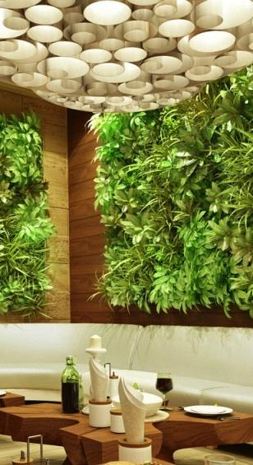
I have a challenge
Understand the challenge.
This will mean deciding on a client, identifying their needs, and knowing how to meet those needs.
Research and gather inspiration.
Knowing how to meet your client’s needs will depend on understanding how similar needs were met in the past. Research each aspect of your challenge to ensure that your solution is sound.

Slide 6
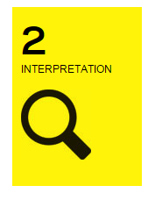
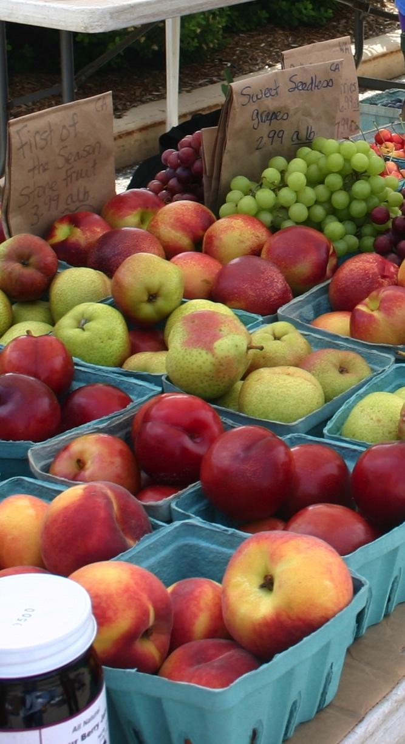
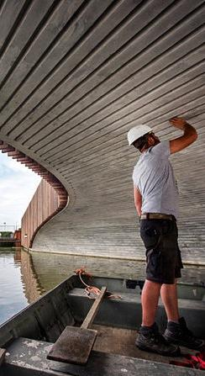
I Learned Something.
Search for Meaning
This can be an exciting step! Ask questions that were brought up by your research. What will this mean to your final solution? How can you overcome?
Identify Opportunities
Once you have thoroughly researched, you will probably have great, new, innovative ideas for how to address your problem and serve your client.

Slide 7
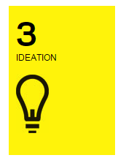
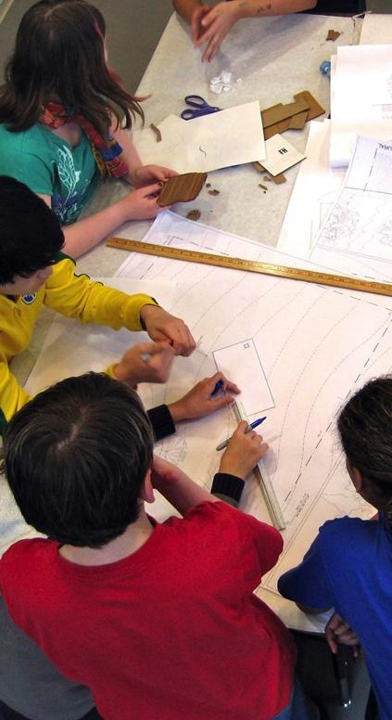
I See an Opportunity
Brainstorm Ideas
Let yourself think without holding back. Push your creativity by writing down or sketching every idea you have, even if you think they are bad ones. Those can turn into some of the best ones.
Describe Ideas/Get Feedback
Now you have an idea of why you are doing this and how you will go about it. Create a presentation for your classmates to tell them – this should be both visual and verbal. Get their feedback, maybe one of them will think of something you hadn’t.

Slide 8
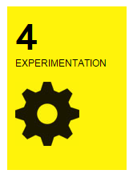
I Have an Idea
Start Tinkering
Have fun with this part. Start to play with materials and figure out how to make different aspects of your model. Look at objects/resources around you in different ways to help create your model.
Bring Your Ideas to Life
Continue to explore materials as you begin to build your model and watch all of your ideas come to life.

Slide 9
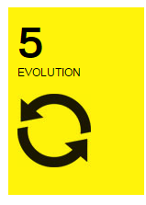
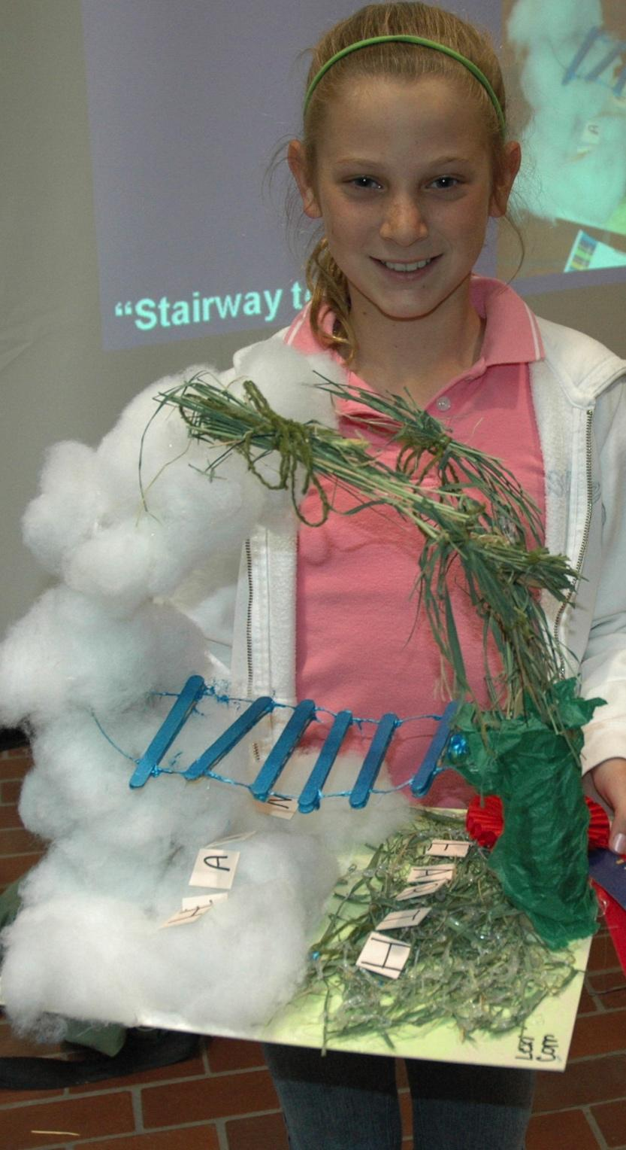
I Tried Something
Develop Your Idea
As you build your model, you may develop your original plan and it may change some. That is exactly what happens to professionals, too!
Share Your Vision
Use your completed model to share your vision. Educate others on the problem you wanted to solve and how you went about solving it.

Slide 10
The Exhibit
The top project in each class will be on display during a week-long exhibit at Newport on the Levee! All other projects will be on display digitally and will compete for the Social Butterfly award.
The Design LAB Exhibit is on display from May 11-May 18. We will have a closing reception to celebrate all of the hard work of each student and award projects that are distinct in certain categories.

Slide 11
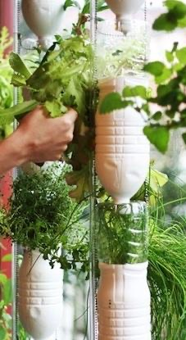
How Did We Decide on Food for Thought?
We thought you might want to learn about something that is relevant to YOU.
You do eat, right?
Chances are you have also purchased food, eaten at a restaurant, and maybe you have even tried to grow food or have made something to eat. There are also a lot of problems regarding food. Of course, for every problem, there is a solution.

Slide 12
Where Our Food is Made
Make a list of the food you ate today.
For each item, answer:
Where did it come from?
How many ingredients were in it?
How was it grown?
Was it an animal or plant?
How far did it travel?
Did you eat all of it?
How does food get to your plate?
https://www.youtube.com/watch?v=WazK8e88axE

Slide 13
This is probably what you think of when you think of food production

Slide 14
We can also grow food in our backyards or on our roofs

Slide 15
We can grow food right on our walls!

Slide 16
Or right at our school!

Slide 17
Where We Get Our Food
What food is available to you?
Some people live in areas where fresh fruits and vegetables are not easily accessible. These places are called food deserts (not to be confused with desserts). Use this site to determine if you live in a food desert: https://www.ers.usda.gov/data-products/food-access-research-atlas/go-to-the-atlas/
Think of the places you get your food. Do you get all of it from a grocery store? Where else can you get food?

Slide 18
Which store would you rather get your food from?

Slide 19
Some stores focus on selling healthy or locally made foods

Slide 20
Food can be delivered and purchased in new ways

Slide 21
How will technology alter how we get our food?

Slide 22
Where We Enjoy Our Food
Where do you like to eat?
Was your answer a place (McDonalds, Findlay Market) or a space (kitchen, on the couch)?
Why do you like eating there? Do you like it because of the food that is available or because of how you feel in the space?
The greenest restaurant in the country is right in your backyard!
https://www.youtube.com/watch?v=jnOJhOfc3M8
Check out these extreme restaurants. Which one would be your favorite to eat at?!
https://www.youtube.com/watch?v=bW1pwnyOKhU

Slide 23
Places can be quite fancy or more rustic

Slide 24
Maybe a robot will be your waiter or your food will be made in a truck

Slide 25
Some provide good company, like this Dog Café & Raccoon Café

Slide 26
Some places have themes to create a more fun environment

Slide 27
More fun themes

Slide 28
Some of those themes are questionable ☺

Slide 29
What will your space look like?

Slide 30
Supplemental Videos
1 in 5 kids in America go hungry, what can you do?
https://www.youtube.com/watch?v=OwIuOVJAn-0
Back to the start – Chipotle illustrates the need for traditional farming methods
https://www.youtube.com/watch?v=S1zXGWK_knQ

Slide 31
The following slides are for K-2 or supplemental for other grades

Slide 32
Types of Buildings
There are SIX main building types to learn about.

Slide 33
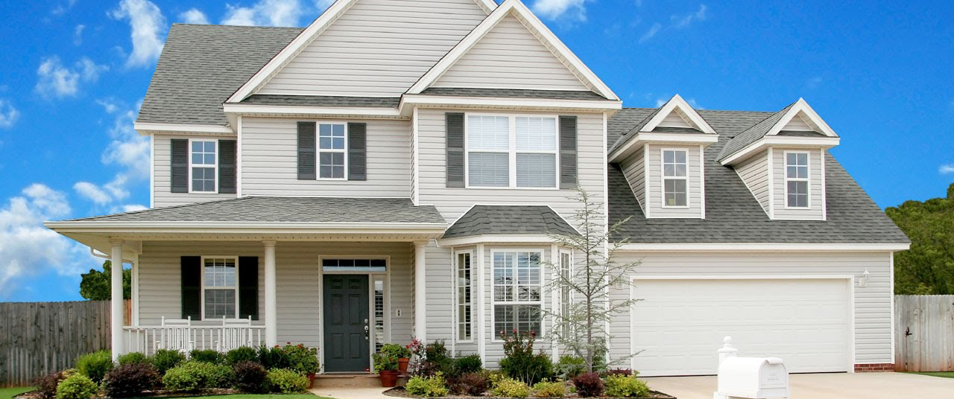
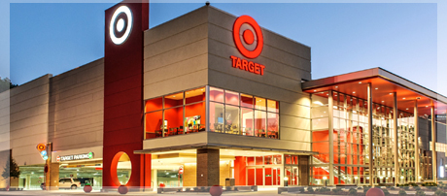
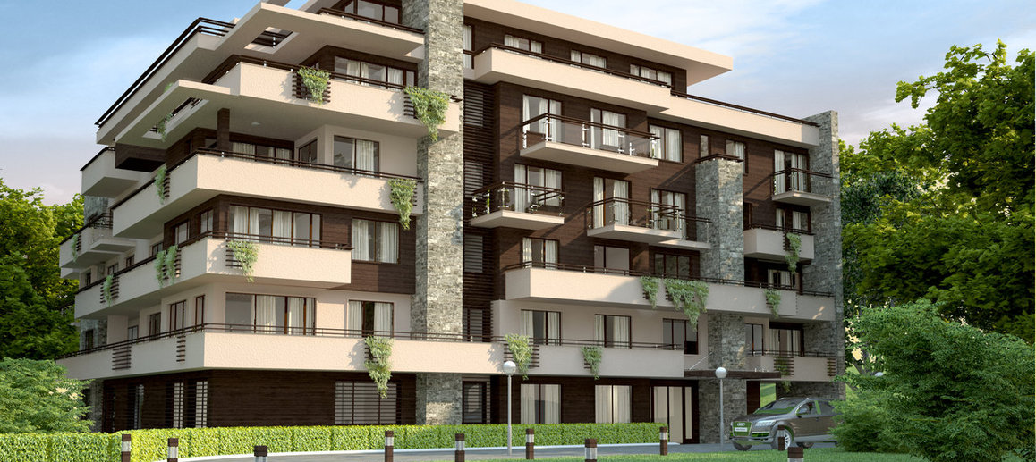
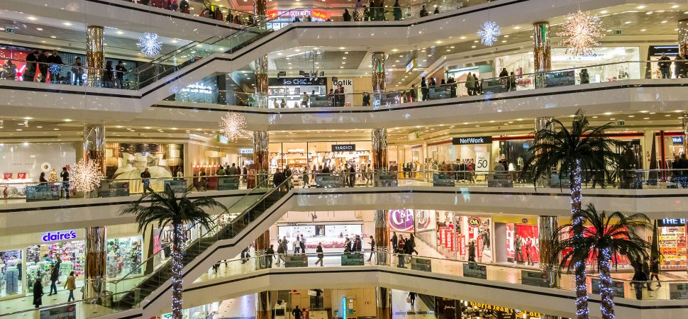
Residential & Commercial
1. Residential
2. Commercial
Places where people live
Places where people buy and sell things
HOUSES
STORES
APARTMENTS
MALLS

Slide 34
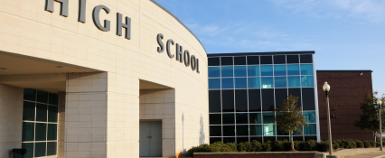
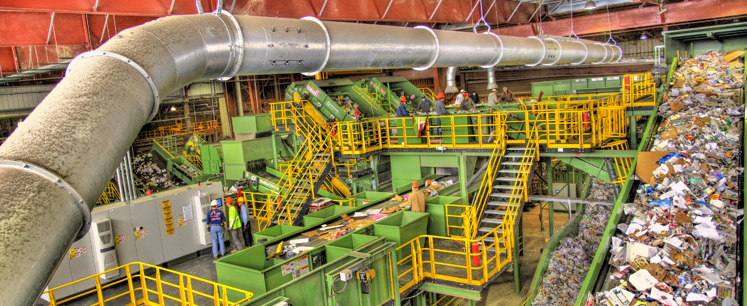
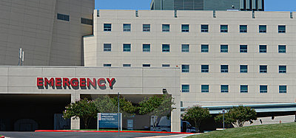
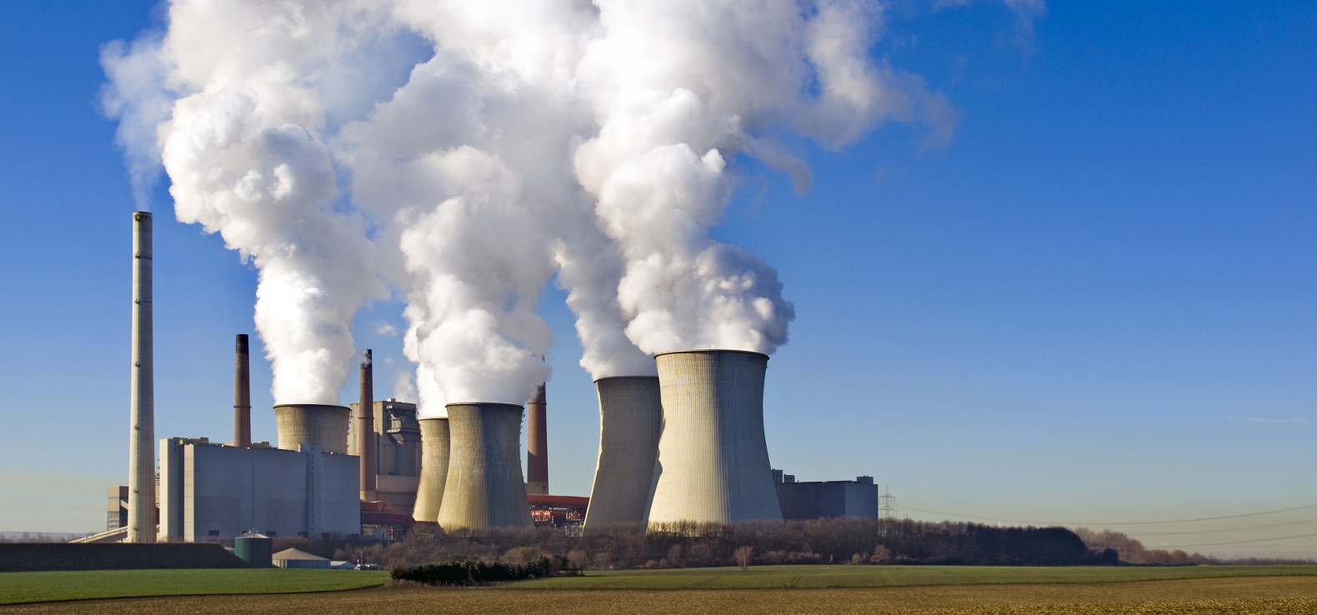
Institutional & Industrial
3. Institutional
4. Industrial
Places where people get help, learn, or receive government services
Places where things are made, disposed of, or processed
SCHOOLS
RECYCLING
CENTERS
POWER
PLANTS
HOSPITALS

Slide 35
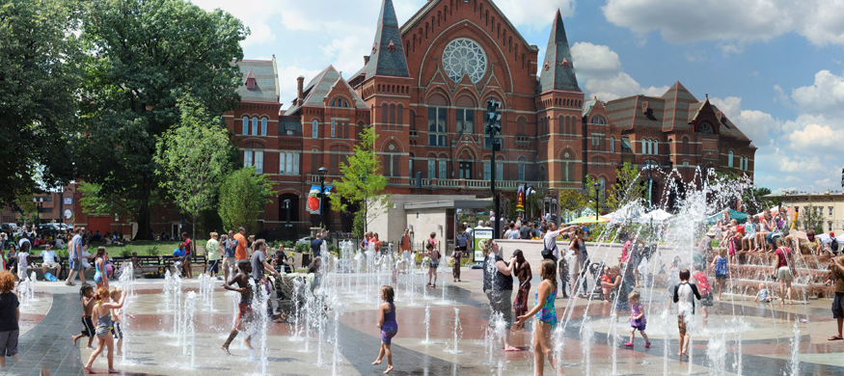
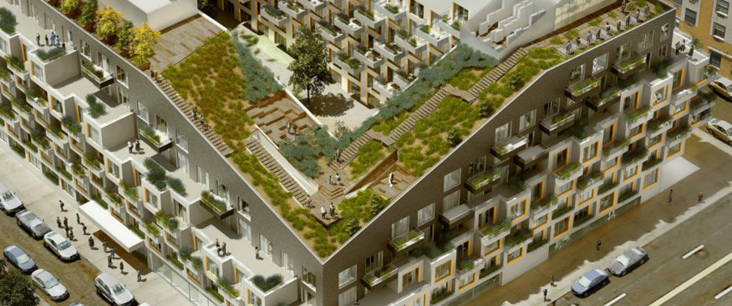
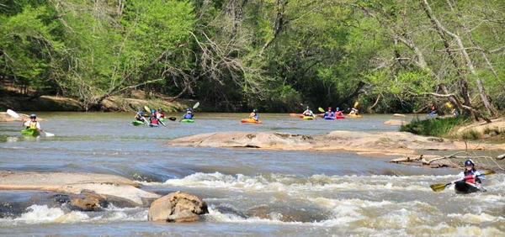
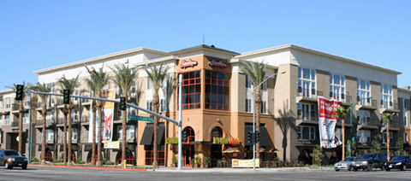
Open/Public Space & Parks, Mixed Use
5. Open/Public Space & Parks
6. Mixed Use
Places where people play, exercise, or enjoy nature
Places that serve more than one function
CITY PARKS
RESIDENTIAL/PARK
NATURE PARKS
RESIDENTIAL/COMMERCIAL

Slide 36
COMMUNITY
These buildings and spaces that surround you make up your community.
Complete the handout shown above and show us what you’ve learned about different types of buildings.

Slide 37
We hope you have so much fun in Design LAB this year!!

