Slide 1
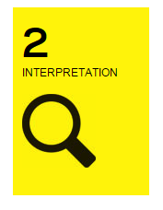
PLAN, SECTION, & ELEVATION
These are different ways to look at a building.

Slide 2
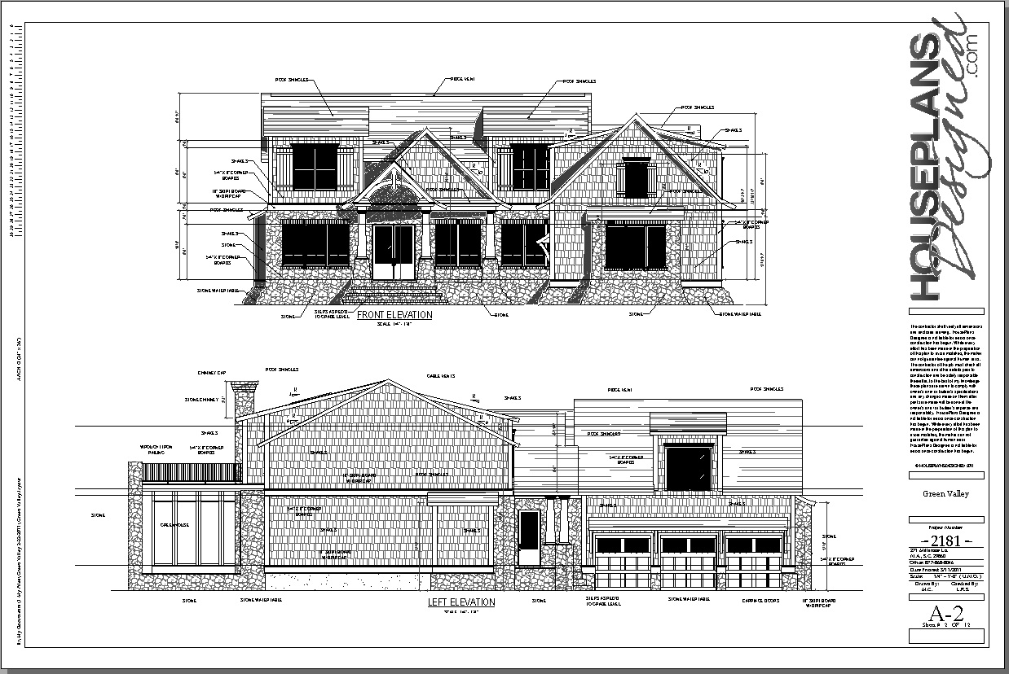
ELEVATION
A drawing of the side of a building.
A direct view to what you are seeing & drawing

Slide 3
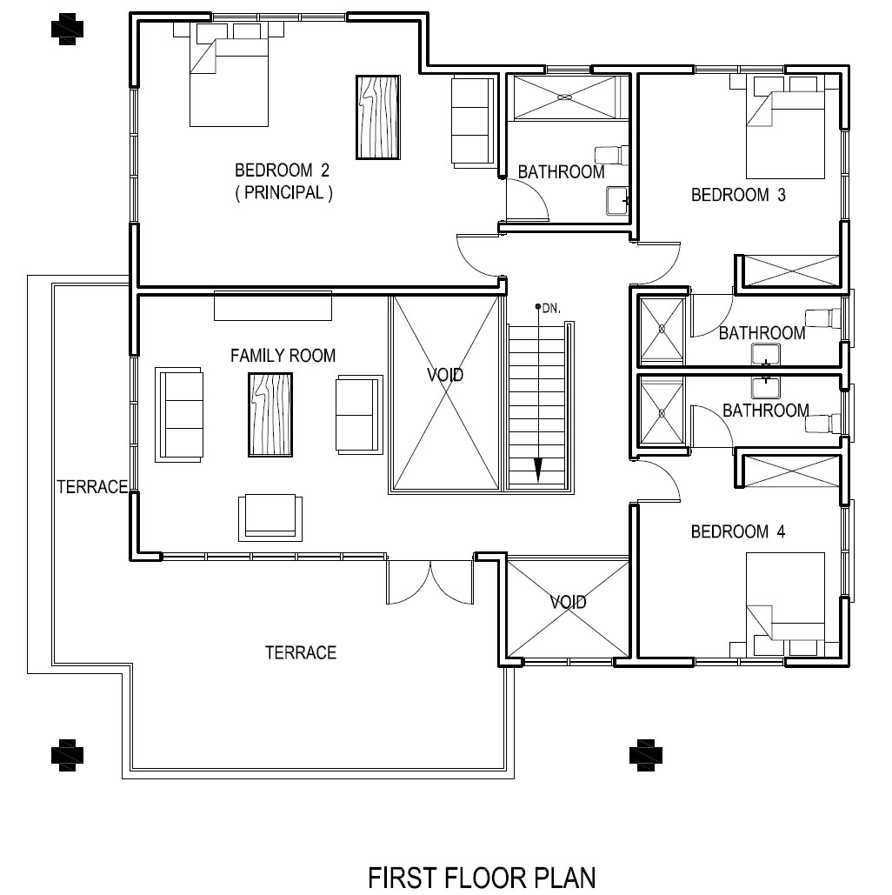
PLAN
A view from above, of the relationships between rooms, spaces, and other physical features at one level of a structure
Dimensions are usually drawn between the walls to specify room sizes and wall lengths

Slide 4
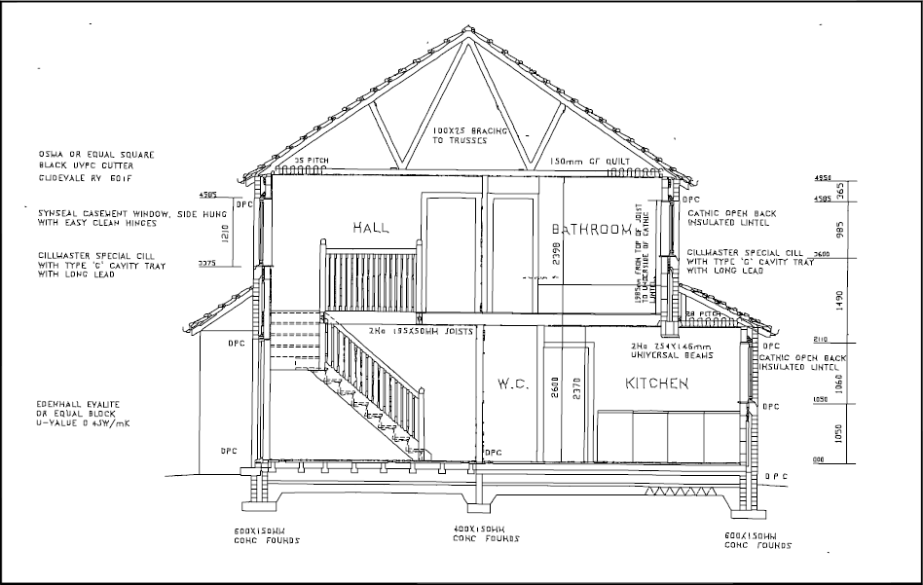
SECTION
If you took a building, and cut it perfectly in half, then drew what you saw, that would be the section.
It reveals vertical relationships within structures.

Slide 5
Try drawing it out yourself!
Instead of buildings though, let’s try it with something a bit more simple.
When you are preparing to build your model, see if you can draw an ELEVATION, PLAN, & SECTION for it!

